Slide 1
Network Layer
Routing

Slide 2
Network Layer
Concerned with getting packets from source to destination.
The network layer must know the topology of the subnet and choose appropriate paths through it.
When source and destination are in different networks, the network layer (IP) must deal with these differences.
Key issue: what service does the network layer provide to the transport layer (connection-oriented or connectionless).

Slide 3
Network Layer Design Goals
The services provided by the network layer should be independent of the subnet topology.
The Transport Layer should be shielded from the number, type and topology of the subnets present.
The network addresses available to the Transport Layer should use a uniform numbering plan (even across LANs and WANs).

Slide 4
Messages
Messages
Transport
layer
Segments
Transport
layer
Network
service
Network
service
Network
layer
Network
layer
Network
layer
Network
layer
End system
α
Data link
layer
Data link
layer
Data link
layer
Data link
layer
End system
β
Physical
layer
Physical
layer
Physical
layer
Physical
layer
Copyright ©2000 The McGraw Hill Companies
Leon-Garcia & Widjaja: Communication Networks
Figure 7.2

Slide 5
Machine A
Machine B
Application
Application
Transport
Router/Gateway
Transport
Internet
Internet
Internet
Network Interface
Network Interface
Network Interface
Network 1
Network 2
Figure 8.3

Slide 6

Metropolitan Area
Network (MAN)
Gateway
Organization Servers
To internet or wide area network
s
s
Backbone
R
R
R
S
Departmental Server
S
S
R
R
R
s
s
s
s
s
s
s
s
s
Copyright ©2000 The McGraw Hill Companies
Leon-Garcia & Widjaja: Communication Networks
Figure 7.6

Slide 7
Wide Area Network
(WAN)
Interdomain level
Border routers
Internet service provider
Autonomous system
or domain
Border routers
LAN level
Intradomain level
Copyright ©2000 The McGraw Hill Companies
Leon-Garcia & Widjaja: Communication Networks
Figure 7.7

Slide 8
(a)
National service provider A
National ISPs
National service provider B
NAP
NAP
National service provider C
Network Access
Point
(b)
NAP
R_{A}
Route server
R_{B}
LAN
R_{C}
Copyright ©2000 The McGraw Hill Companies
Leon-Garcia & Widjaja: Communication Networks
Figure 7.8

Slide 9
Datagram Packet Switching
Packet 1
Packet 1
Packet 2
Packet 2
Packet 2
Copyright ©2000 The McGraw Hill Companies
Leon-Garcia & Widjaja: Communication Networks
Figure 7.15

Slide 10
Routing Table
in Datagram Network
Destination
address
Output
port
0785
7
1345
12
1566
6
2458
12
Copyright ©2000 The McGraw Hill Companies
Leon-Garcia & Widjaja: Communication Networks
Figure 7.16

Slide 11
Virtual Circuit Packet Switching
Packet
Packet
Copyright ©2000 The McGraw Hill Companies
Leon-Garcia & Widjaja: Communication Networks
Figure 7.17

Slide 12
Routing Table
in Virtual Circuit Network
Identifier
Output
port
Next
identifier
12
13
44
Entry for packets
with identifier 15
15
15
23
27
13
16
58
7
34
Copyright ©2000 The McGraw Hill Companies
Leon-Garcia & Widjaja: Communication Networks
Figure 7.21

Slide 13
Routing
Routing algorithm:: that part of the Network Layer responsible for deciding on which output line to transmit an incoming packet.
Remember: For virtual circuit subnets the routing decision is made ONLY at set up.
Algorithm properties:: correctness, simplicity, robustness, stability, fairness, optimality, and scalability.

Slide 14
Routing Classification
Adaptive Routing
based on current measurements
of traffic and/or topology.
1. centralized
2. isolated
3. distributed
Non-Adaptive Routing
flooding
static routing using shortest path algorithms

Slide 15
Shortest Path Routing
Bellman-Ford Algorithm [Distance Vector]
Dijkstra’s Algorithm [Link State]
What does it mean to be the shortest (or optimal) route?
Minimize mean packet delay
Maximize the network throughput
Mininize the number of hops along the path

Slide 16
Dijkstra’s Shortest Path Algorithm
Initially mark all nodes (except source) with infinite distance.
working node = source node
Sink node = destination node
While the working node is not equal to the sink
1. Mark the working node as permanent.
2. Examine all adjacent nodes in turn
If the sum of label on working node plus distance from working node to adjacent node is less than current labeled distance on the adjacent node, this implies a shorter path. Relabel the distance on the adjacent node and label it with the node from which the probe was made.
3. Examine all tentative nodes (not just adjacent nodes) and mark the node with the smallest labeled value as permanent. This node becomes the new working node.
Reconstruct the path backwards from sink to source.

Slide 17
Internetwork Routing [Halsall]
Adaptive Routing
Centralized
Distributed
[RCC]
[IGP]
Intradomain routing
Interdomain routing
[EGP]
Interior
Gateway Protocols
[BGP,IDRP]
Exterior
Gateway Protocols
Distance Vector routing
Link State routing
[RIP]
[OSPF,IS-IS,PNNI]

Slide 18
Distance Vector Routing
Historically known as the old ARPANET routing algorithm {or known as Bellman-Ford algorithm}.
Basic idea: each network node maintains a Distance Vector table containing the distance between itself and ALL possible destination nodes.
Distances are based on a chosen metric and are computed using information from the neighbors’ distance vectors.
Metric: usually hops or delay

Slide 19
Distance Vector Routing
Information kept by DV router
each router has an ID
associated with each link connected to a router, there is a link cost (static or dynamic) the metric issue!
Distance Vector Table Initialization
Distance to itself = 0
Distance to ALL other routers = infinity number

Slide 20
Distance Vector Algorithm [Perlman]
Router transmits its distance vector to each of its neighbors.
Each router receives and saves the most recently received distance vector from each of its neighbors.
A router recalculates its distance vector when:
  It receives a distance vector from a neighbor containing different information than before.
  It discovers that a link to a neighbor has gone down (i.e., a topology change).
The DV calculation is based on minimizing the cost to each destination.

Slide 21
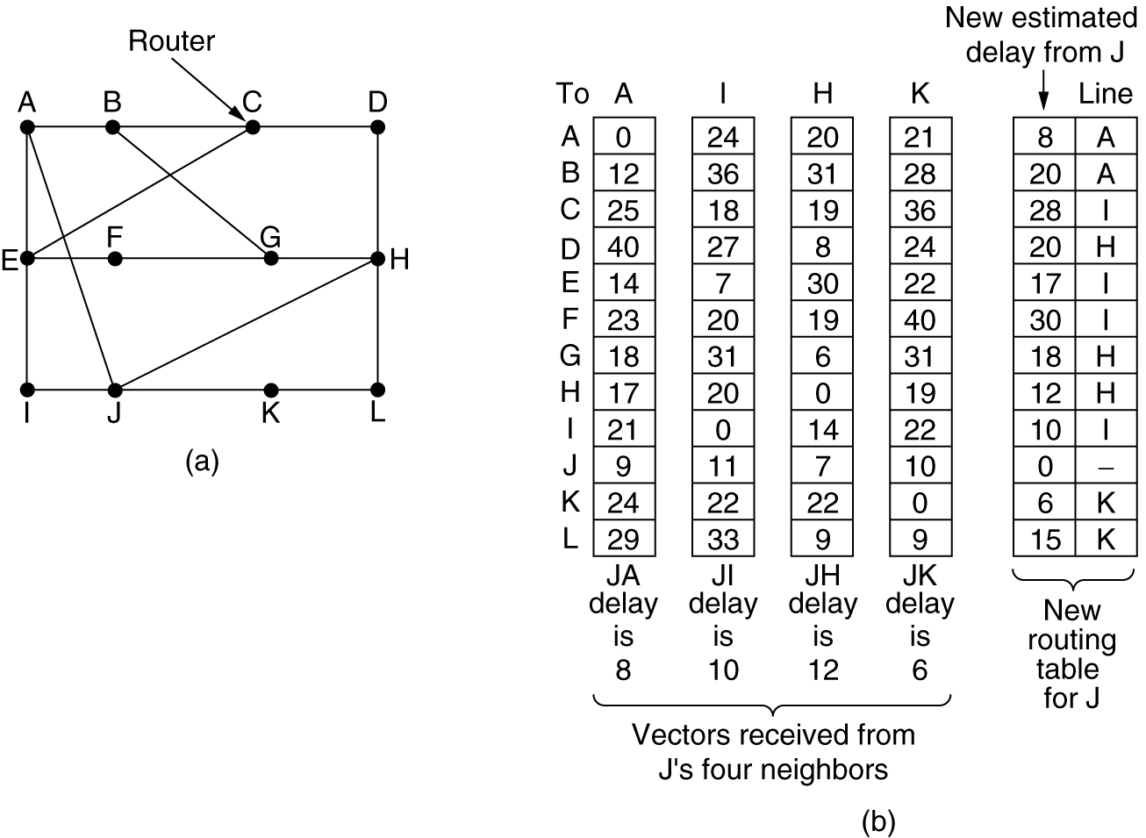
Distance Vector Routing
Figure 5-9.(a) A subnet. (b) Input from A, I, H, K, and the new routing table for J.

Slide 22
Routing Information Protocol (RIP)
RIP had widespread use because it was distributed with BSD Unix in “routed”, a router management daemon.
RIP is the most used Distance Vector protocol.
RFC1058 in June 1988.
Sends packets every 30 seconds or faster.
Runs over UDP.
Metric = hop count
BIG problem is max. hop count =16
➔ RIP limited to running on small networks!!
Upgraded to RIPv2

Slide 23
Link State Algorithm
Each router is responsible for meeting its neighbors and learning their names.
Each router constructs a link state packet (LSP) which consists of a list of names and cost to reach each of its neighbors.
The LSP is transmitted to ALL other routers. Each router stores the most recently generated LSP from each other router.
Each router uses complete information on the network topology to compute the shortest path route to each destination node.

Slide 24
Open Shortest Path First
(OSPF)
OSPF runs on top of IP, i.e., an OSPF packet is transmitted with IP data packet header.
Uses Level 1 and Level 2 routers
Has: backbone routers, area border routers, and AS boundary routers
LSPs referred to as LSAs (Link State Advertisements)
Complex algorithm due to five distinct LSA types.

Slide 25
OSPF Areas
To another AS
N1
R1
N5
N2
R3
R6
N4
R7
R2
N6
R4
R5
N3
Area 0.0.0.1
Area 0.0.0.0
R8
Area 0.0.0.2
N7
R = router N = network
Area 0.0.0.3
Copyright ©2000 The McGraw Hill Companies
Leon-Garcia & Widjaja: Communication Networks
Figure 8.33

Slide 26
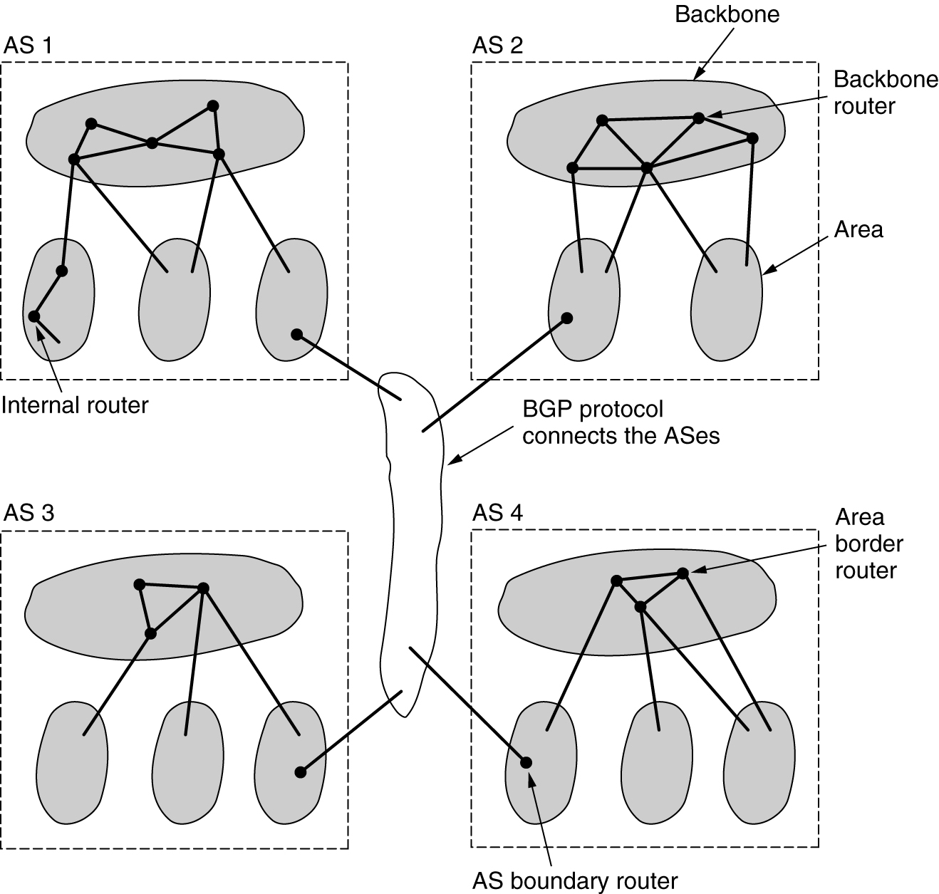
OSPF
Figure 5-65.The relation between ASes, backbones, and areas in OSPF.

Slide 27
Border Gateway Protocol (BGP)
The replacement for EGP is BGP. Current version is BGP-4.
BGP assumes the Internet is an arbitrary interconnected set of AS’s.
In interdomain routing the goal is to find ANY path to the intended destination that is loop-free. The protocols are more concerned with reachability than optimality.

